Slide 1
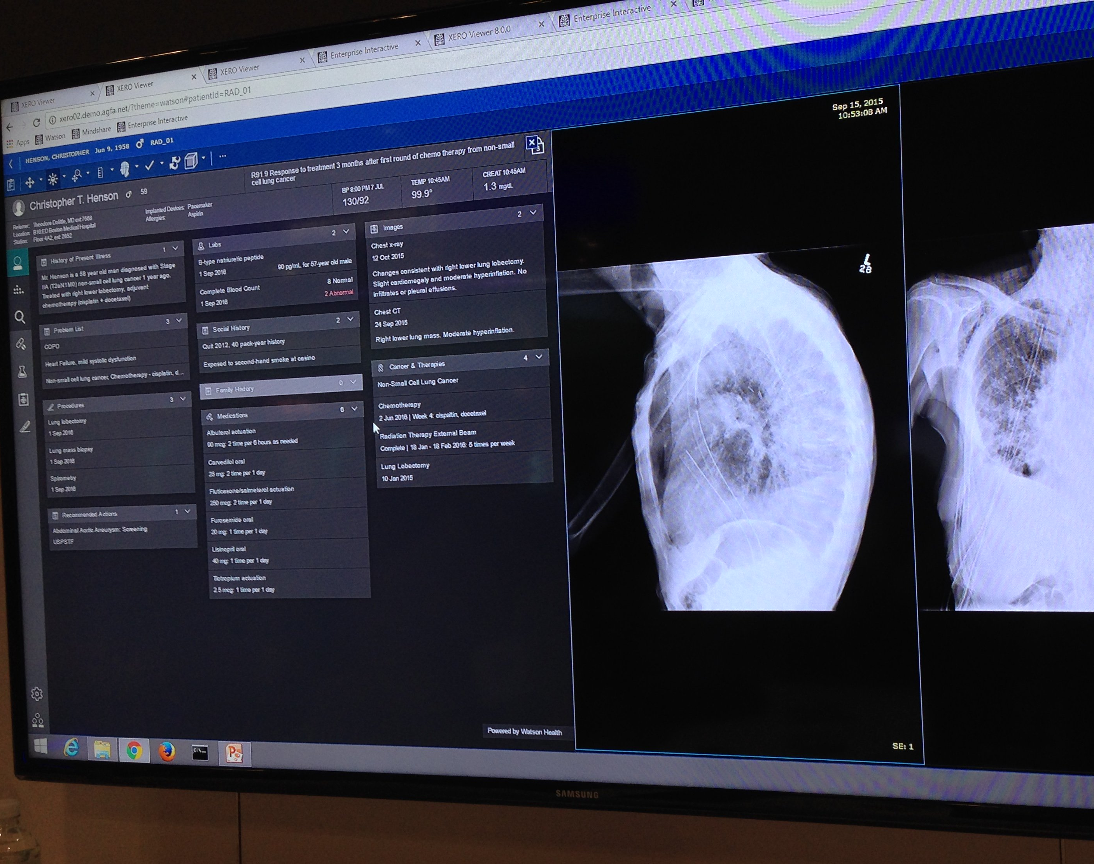
AI in Heart Diseases

Slide 2
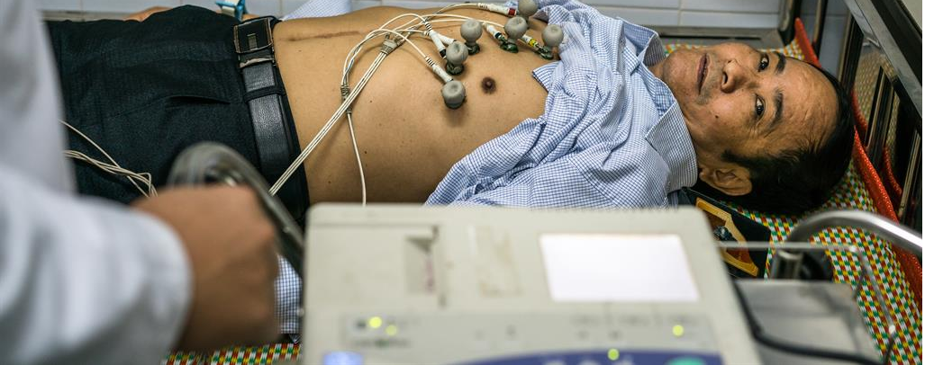
Cardiovascular diseases
Cardiovascular diseases are the number one cause of death globally, according to the World Health Organization.
Taking an estimated 17.9 million lives each year.
one third of these deaths occur prematurely in people under 70 years of age.

Slide 3
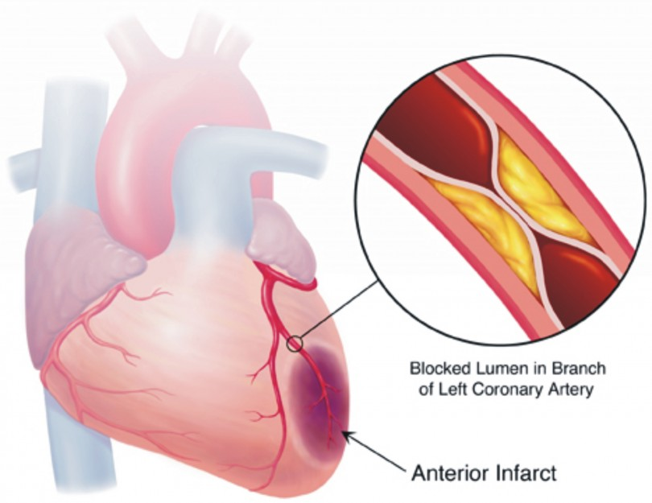
How is deep learning helps in cardiac imaging analysis
Deep learning can help to analyze
coronary angiography
echocardiography and electrocardiogram (ECG).
identify coronary atherosclerotic plaques more accurately than clinicians.

Slide 4
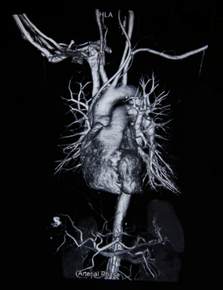
Cardiac intervention has been the main treatment for cardiovascular disease in recent decades.
AI can also be used to analyze echocardiographic images.
automatic measurement of the size of each chamber and assessment of left ventricular function.
it can be used to assess structural diseases,
such as valvular disease, to help determine
the classification and staging of the disease.

Slide 5
A group of experiments uses artificial intelligence
Rima Arnaout, an assistant professor at the University of California, San Francisco, built convolutional neural networks by using the echocardiographies of 267 randomized patients (age range: 20–96 years) between 2000 and 2017 from the university medical center.
From the perspective, 223,000 images were divided into fifteen categories. Furthermore, this classification algorithm has outperformed the human cardiovascular physicians in the classification competition of cardiac ultrasound images.

Slide 6
A group of experiments use artificial intelligence
Another study from Samad, et al.
demonstrated that deep learning can predict survival with higher accuracy after analyzing echocardiography of multiple cases.
Other applications of AI in cardiac imaging analysis include intravascular ultrasound (for the detection of the border of the lumen and the media-adventitia)
optical coherence tomography (for the classification of the three layers of the coronary artery)

Slide 7
A group of experiments use artificial intelligence
cardiac single-photon emission computed tomography (for the diagnosis of myocardial ischemia.
the improvement of the diagnostic accuracy of myocardial perfusion imaging)
MRI (for the efficient and fast visualization of the cardiac segmentation in short-axis MRI).

Slide 8
A Fully Convolutional Neural Network for Cardiac Segmentation in Short-Axis MRI.
We propose to tackle the problem of automated left and right ventricle segmentation through the application of a deep fully convolutional neural network architecture.
Our model is efficiently trained end-to-end in a single learning stage from whole-image inputs and ground truths to make inference at every pixel.
this is the first application of a fully convolutional neural network architecture for pixel-wise labeling in cardiac magnetic resonance imaging.
The models and code are available at https://github.com/vuptran/cardiac-segmentation.

Slide 9
Deep learning segmentation of major vessels in X-ray coronary angiography
There are a number of open technical challenges in automated left ventricle (LV) and right ventricle (RV) segmentation
The overlap of pixel intensity distributions between cardiac objects and surrounding background structures.
The shape variability of the endocardial and epicardial contours across slices and phases;
Extreme imbalance in the number of pixels belonging to object class versus background;
Fuzzy boundary and edge information, especially in basal and apical slices;
Variability in cine MRI from different institutions, scanners, and populations;
Inherent noise associated with cine MRI.

Slide 10
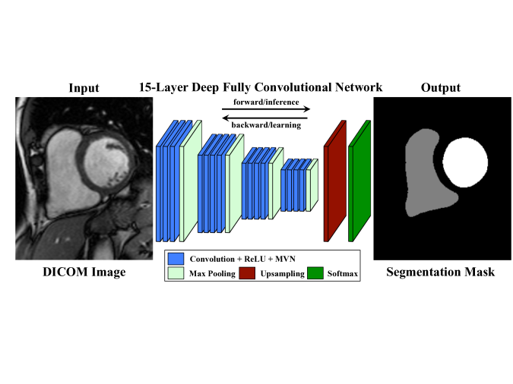
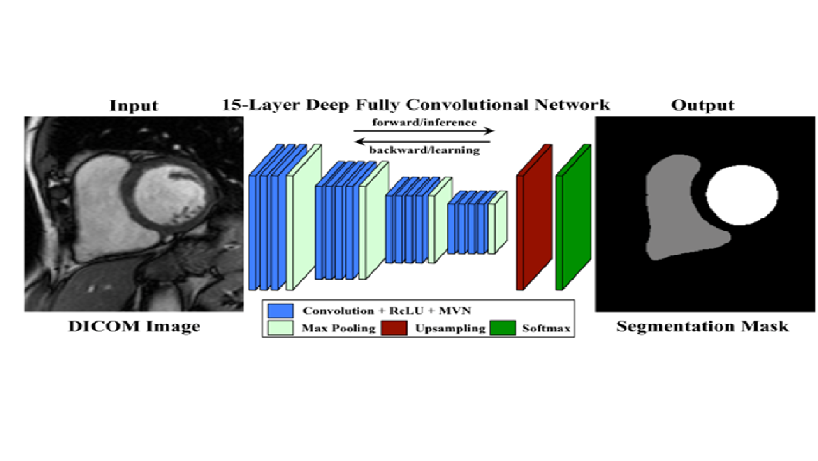

Slide 11
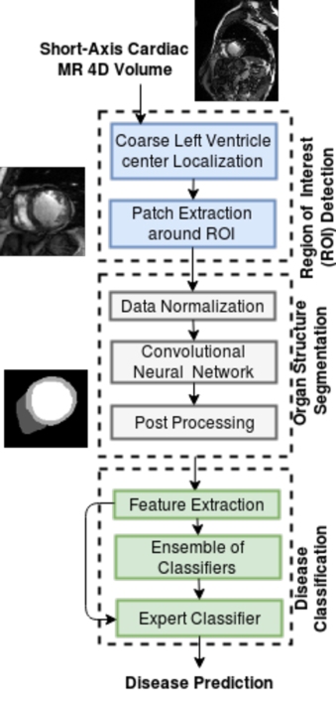
Results of comparison study for analyzing the effectiveness
Illustrates our automated cardiac segmentation and disease diagnosis framework. The pipeline involves:
Fourier analysis and Circular Hough-Transform for Region of Interest (ROI) cropping.
Proposed network for cardiac structures segmentation.
An ensemble of classifiers for disease diagnosis based on features extracted from the segmentation.

Slide 12
References
https://www.who.int/health-topics/cardiovascular-diseases/#tab=tab_1
https://github.com/vuptran/cardiac-segmentation
https://www.groundai.com/project/a-fully-convolutional-neural-network-for-cardiac-segmentation-in-short-axis-mri/3
https://www.ncbi.nlm.nih.gov/pmc/articles/PMC6748906/#:~:text=Through%20machine%20learning%20and%20big,death%20for%20heart%20disease%20patients.

